Slide 1
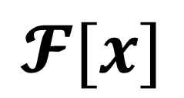

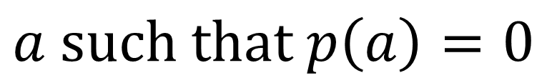

$$𝓕[x]$$
$$p\left(x\right)$$
$$(arbitrary)$$
$$𝓕$$
*
$$a such that p\left(a\right)=0$$

Slide 2

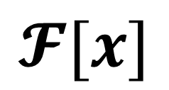
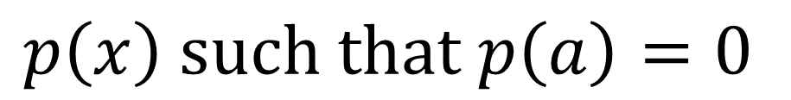

E
$$𝓕[x]$$
$$a$$
$$𝓕$$
*
$$p\left(x\right) such that p\left(a\right)=0$$

Slide 3
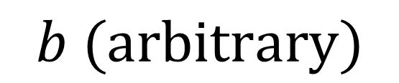

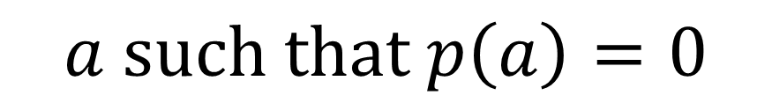

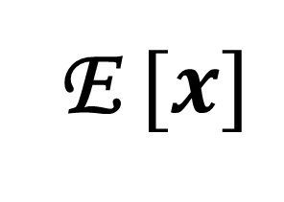

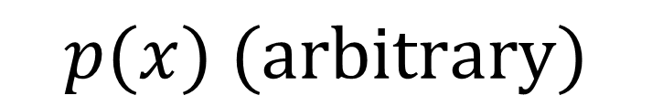
E $[x]$
$$b (arbitrary)$$
$$p(x) (arbitrary)$$
E
$$𝓕[x]$$
*
$$𝓕$$
*
$$a such that p\left(a\right)=0$$
$$f\left(x\right) such that f\left(b\right)=0$$

